Slide 1
Angular Best practices Sharing
27-05-2021
Author: Nguyen Le Hong Trieu

Slide 2
Agenda
Prerequisites
What/Why is Angular?
Angular Best Practies
Application Structure and Organization
Lazy Loading Feature Modules
Service Injector Best Practices
Improve Perfomance with OnPush Change Detection
Pure and Impure Pipe Performance

Slide 3

Prerequisites
HTML
JavaScript
TypeScript
Node.js and npm (node package manager)
Angular
What the heck is Angular? Should I still be here?

Slide 4
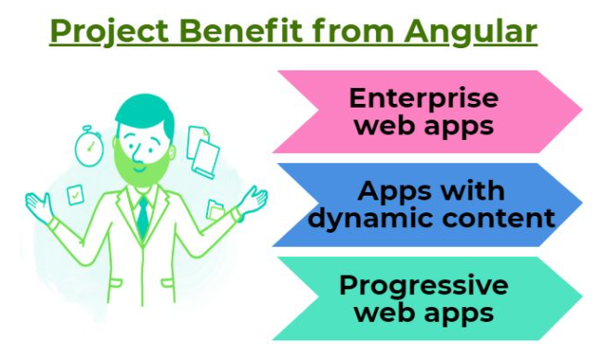
What/Why is Angular
Open-source front-end framework developed by Google
Built on TypeScript
Creating dynamic, modern web apps
Component-based
Well-integrated libraries
Support Testing
Single Page Application E.g: https://angular.io/

Slide 5

Application Structure and Organization
There’s almost impossible to find a structure that suits every single use-case.
The structure of an application will change a lot depending on the project, and there’s no blueprint here
Scalable
Maintainable
Readable

Slide 6
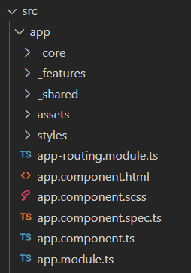
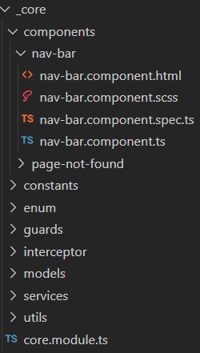
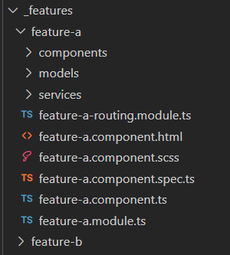
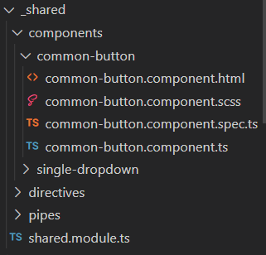
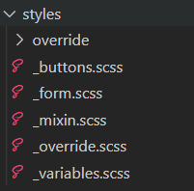
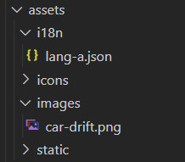
Application Structure and Organization https://medium.com/@shijin_nath/angular-right-file-structure-and-best-practices-that-help-to-scale-2020-52ce8d967df5

Slide 7
Application Structure and Organization
Core Module
Singleton
Root-scoped services
Static components: navbar and footer
Interceptors, guard, constants, enums, utils

Slide 8
Application Structure and Organization
Share Module
Items which are re-used and referenced by the components declared in other features
components, directives, and pipes
shouldn’t have any dependency to the rest of the application

Slide 9
Application Structure and Organization
Features Module
Based on functionality/ business area
Should only depend on the SharedModule
Their functionality should be scoped to the module
Can be lazy loaded

Slide 10

Lazy Loading Feature Modules
SPA problem?
All of its components are loaded at once. This means that a lot of unnecessary libraries or modules might be loaded as well.
What is Lazy Loading?
Is the process of loading components, modules, or other assets of a website as they're required
https://angular.io/guide/ngmodules

Slide 11
Lazy Loading Feature Modules
Lazy Loading problem?
How about implicitly loading other Modules after lazy loading a module
What is Pre-Loading?
Feature Modules under Pre-Loading would be loaded automatically after the application starts
When to use {Eager Loading, Lazy Loading, Pre-Loading}?
Small size applications
Core modules and feature modules that are required to start the application
Big-size web application
Specific modules that users are very likely to use after the application started

Slide 12
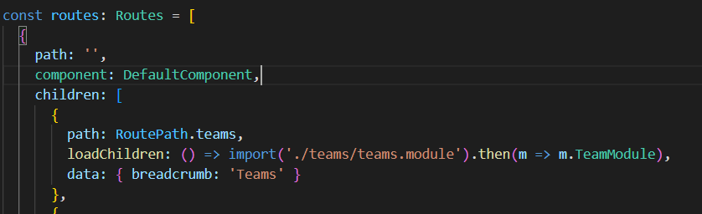
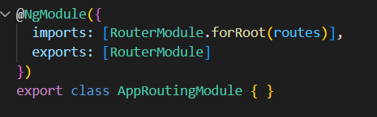
Lazy Loading Feature Modules
How to implement?
Angular Routing
loadChildren: () => import(‘~/path').then(m => m.LazyLoadedModule)

Slide 13
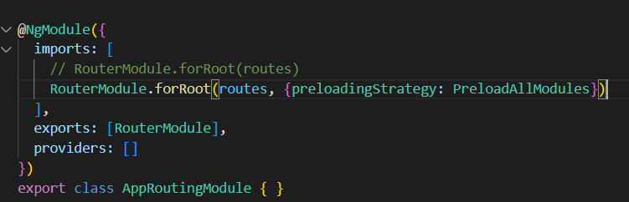
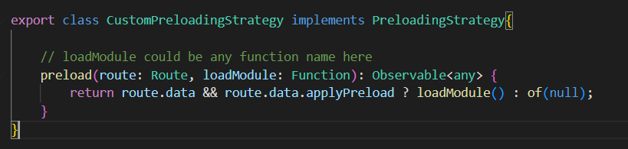
Lazy Loading Feature Modules
How to implement? - Pre-Loading
Customization

Slide 14
Lazy Loading Feature Modules
Code Demo

Slide 15
Service Injector Best practices
How many UserService instances will be initialized? 1 – 2 – 3 - 6
AppModule providers: [UserService]
ProductModule
providers: [UserService]
OrderModule
providers: [UserService]
ProductsComponent constructor(private service: UserService)
OrderComponent constructor(private service: UserService)
ProductDetailsComponent constructor(private service: UserService)

Slide 16
Service Injector Best practices
How many UserService instances will be initialized? 1 – 2 – 3 - 6
AppModule providers: [UserService]
ProductModule
providers: [UserService]
OrderModule (Lazy loaded)
providers: [UserService]
ProductsComponent constructor(private service: UserService)
OrderComponent constructor(private service: UserService)
ProductDetailsComponent constructor(private service: UserService)

Slide 17
Service Injector Best practices
How many UserService instances will be initialized? 1 – 2 – 3 - 6
AppModule providers: [UserService]
ProductModule
providers: [UserService]
OrderModule (Lazy loaded)
providers: [UserService]
ProductsComponent constructor(private service: UserService)
OrderComponent constructor(private service: UserService)
ProductDetailsComponent
providers: [UserService] constructor(private service: UserService)

Slide 18
Service Injector Best practices
Hierarchical injectors
ModuleInjector hierarchy | Configure a ModuleInjector in this hierarchy using an @NgModule() or @Injectable() annotation.
ElementInjector hierarchy | Created implicitly at each DOM element. An ElementInjector is empty by default unless you configure it in the providers property on @Directive() or @Component().

Slide 19
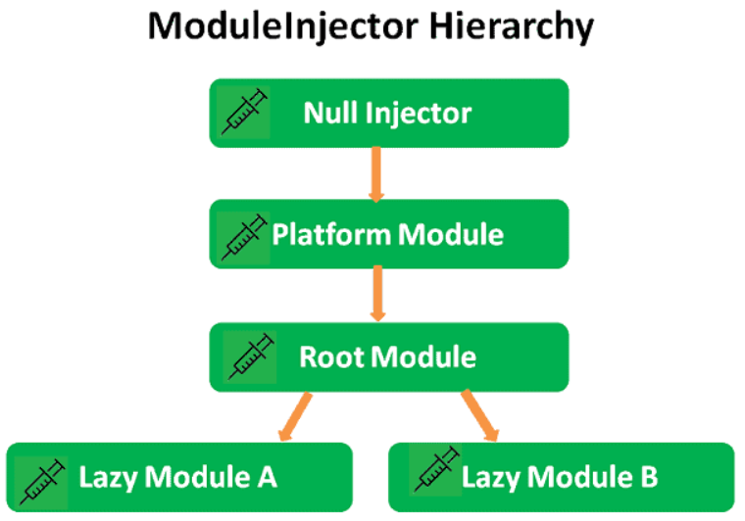
Service Injector Best practices

Slide 20
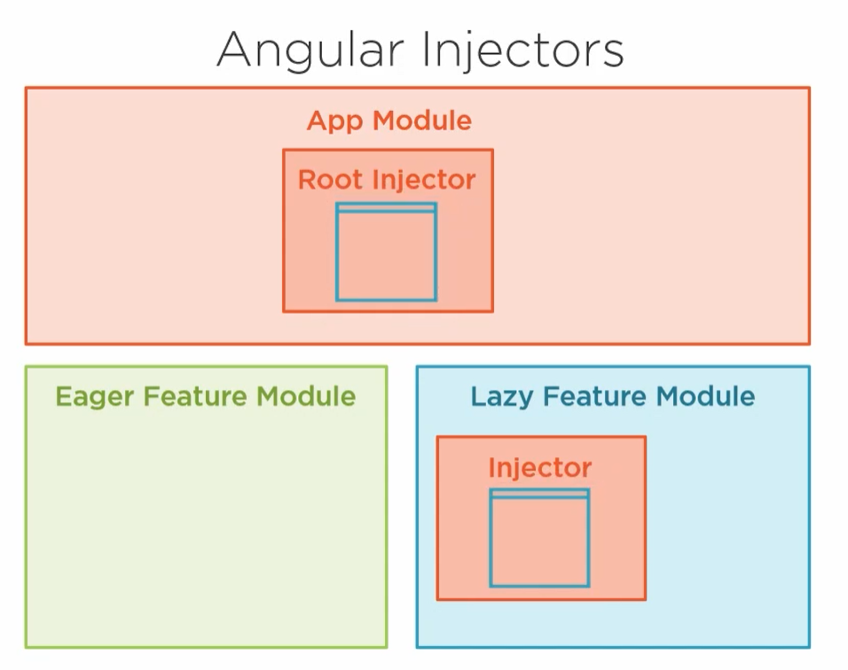

Service Injector Best practices

Slide 21
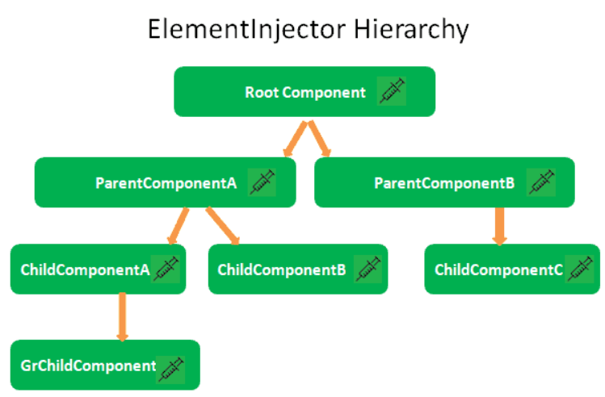
Service Injector Best practices

Slide 22
Service Injector Best practices
Code Demo

Slide 23
Improve Perfomance with OnPush Change Detection
Change Detection
Change Detection means updating the DOM whenever data is changed (@Input)
Angular change detector will traverse the component tree and update the DOM
Caused by:
Events fired such as button click, etc.
AJAX call or XHR requests.
Use of JavaScript timer functions such as setTimeOut , SetInterval
ChangeDetectionStrategy: Default vs OnPush

Slide 24
Improve Perfomance with OnPush Change Detection
Change Detection: Default
Component will run the change detector whenever any data is mutated or changed

Slide 25
Improve Perfomance with OnPush Change Detection
Change Detection: OnPush
Component only run the change detector when a new reference is passed to @Input() data

Slide 26
Improve Perfomance with OnPush Change Detection
Code Demo

Slide 27
Pure and Impure Pipe Performance
What is Angular Pipe?
Use pipes to transform strings, currency amounts, dates, and other data for display
https://angular.io/guide/pipes
A pure pipe
is only called when Angular detects a change in the value or the parameters passed to a pipe.
An impure pipe
is called for every change detection cycle no matter whether the value or parameter(s) changes.

Slide 28
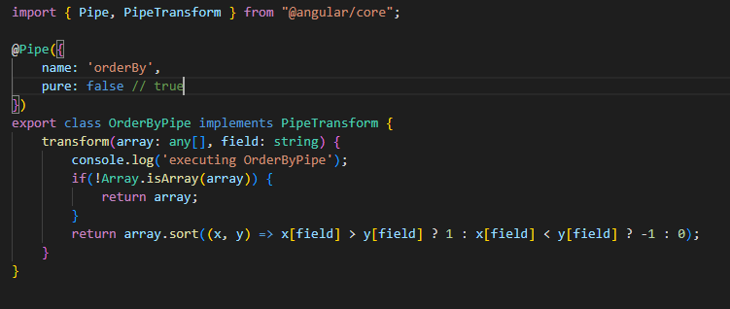
Pure and Impure Pipe Performance

Slide 29
Pure and Impure Pipe Performance
Code Demo

Slide 30
Q & A

Slide 31
T HANK YOU

